Slide 1
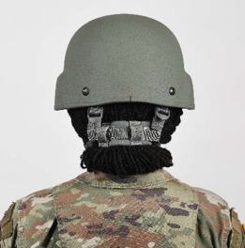
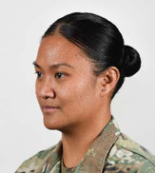
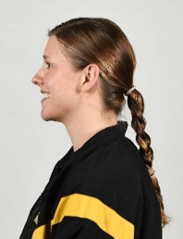
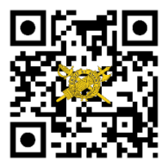
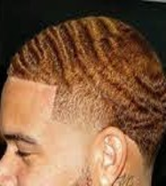
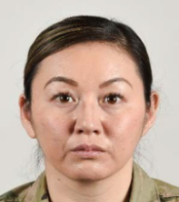
THE
Your Unit
Patch / Crest
Here.
IG UPDATE
Volume 21-1, March 2021
Guidance on Updates to Appearance and Grooming Standards Policies
On February 24, 2021, to further promote diversity and inclusion within the Army and strengthen the People First Initiative, the Acting Secretary of the Army released guidance entitled, “Appearance and Grooming Policies for the United States Army.” This memorandum and the associated Deputy Chief of Staff, G–1, ALARACT 016-2021 (United States Army Appearance and Grooming Standards), and supplemental training packet supersedes Chapter 3 of Army Regulation (AR) 670-1 (Wear and Appearance of Army Uniforms and Insignia). These changes reflect the Army’s commitment to fostering an environment that promotes and facilitates diversity, equity, and inclusion. Upcoming revisions to AR 670-1, Ch. 3 follow:
Hairstyles, Color, and Length:
Female Soldiers can wear “multiple” hairstyles at once (e.g., braided twists or loc hair style with a side twist) as long as they are neat and do not impact proper wear of headgear and equipment. Additionally, these braids, twists, and locs do not have to be the same dimensions or have approximate size of spacing between them.
Female and male Soldiers are authorized to wear highlights, as long as colors blend naturally together (i.e., natural black hair with blond highlights/streaks is unauthorized). Unnatural hair colors (purple, pink, blue, etc.) are also unauthorized (applies to extensions, wigs, and hairpieces).
Minimum hair length for female Soldiers is no longer required (authorized to taper hair if it does not part naturally, and cut a straight part into hair (designs in hair remain unauthorized)).
Ponytails:
Female Soldiers unable to form a bun due to length and or hair texture are authorized to have a medium and short length ponytail. Ponytail must be centered in the back of the head. It cannot be wider than the width of the head, or extend beyond the lower edge of the collar.
Female Soldiers are also authorized to wear long ponytails in utility uniforms when conducting PT or tactical operations (*long ponytail authorized when walking to and from designated area of PT; not authorized if you are not actively participating in PT). Additionally, while female Soldiers are wearing equipment (e.g., CVC/ACH), they can wear their hair in a ponytail and or long braid secured in their utility uniform top.
* Commanders should always use reason when enforcing these ponytail-related standards and recognize the intent of these changes and goal of dignity and respect always.
Your Unit Name Here
Commanding General
MG Soldier Q. Public
Command Sergeant Major
CSM Soldier Q. Public
Command Inspector General
LTC Soldier Q. Public
Inspector General NCOIC
SGM Soldier Q. Public
ig.army.mil

Slide 2
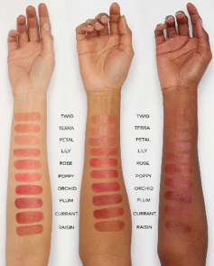
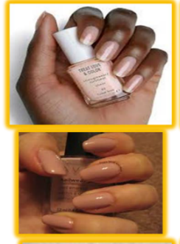
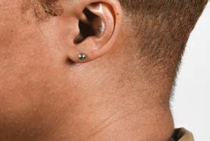
THE
Your Unit
Patch / Crest
Here.
IG UPDATE
Volume 21-1, March 2021, con.
Guidance on Updates to Appearance and Grooming Standards Policies
Lipstick: Female Soldiers can wear solid color shades of lipstick and tinted lip glosses. Extreme colors (e.g., purple, bright pink, hot pink, green, etc.) are unauthorized.
Earrings:
Female Soldiers can wear stud earrings in their army combat uniform. Studs must be screw-on, clip on, or post-type in gold, silver, or diamond. Pearls are authorized only in formal attire (service or dress uniform). Hoop and two-sided or drop earrings are unauthorized.
Earrings cannot exceed 6mm or 1/4 inch in diameter, and they must be plain or round. Earrings must also fit snugly against the ear.
Female Soldiers may wear earrings only as a matched pair, with only one earring per standard ear lobe. Earrings cannot be worn in the cartilage, industrial, transverse lobe, tragus, or conch part of the ear. Earrings cannot be worn in field environments, combat-related environments or deployments, and locations where normal hygiene is unavailable.
In addition to these revisions, the ALARACT includes the removal of offensive/weaponized wording (e.g., Mohawk, Fu Manchu, dreadlock, eccentric, and faddish). Updates to AR 670-1 will include appropriate terminology for unauthorized grooming and appearance standards.
The future revisions of AR 670-1 and DA Pamphlet 670-1 will provide updated imagery and examples to equip the army with specific examples for standards in regard to appearance and grooming.
Nail Polish:
Female Soldiers can wear solid color shades of nail polish (e.g., nude/natural shades, American manicure and light pink). Extreme colors (e.g., purple, bright pink, red, blue, black, neon, French manicure, etc.) remain unauthorized.
Male Soldiers can wear clear nail polish while in service uniforms. Nails cannot exceed ¼ inch from the tip of the finger.
IG Points of Contact
Unit IG Office
Building 1234
Hooah Drive
Fort Swampy LA 55555
Unit IG Website
http:\IG-bla-bla-bla.mil
Unit IG Office Email
IG-bla-bla@mail.mil
Unit IG Hotline
555-555-5555
Unit IG Office
555-555-5555
This update highlights revisions to AR 670-1 and DA PAM 670-1 as described in ALARACT 016-2021. For more details, please review these originating documents.

